Slide 1
FeatureSmith: Automatically Engineering Features for Malware Detection by Mining the Security Literature
Ziyun Zhu and Tudor Dumitras
University of Maryland College Park, MD, USA
CCS ‘16 October 24-28, 2016, Vienna Austria
Presented by Pranav Jain, 50169659

Slide 2
Motivation
Constant competition between Android malware and the security community
Security community has to constantly propose new features
Drebin – 545,334 features from 8 different classes
Hypotheses – formulated by human researchers
Google Scholar – 12,400 papers on Android malware and over 600,000 on intrusion detection
Volume of scientific publications growing exponentially – so only fraction of relevant knowledge is likely drawn

Slide 3
Can this manual process be automated?
Analyze the content of papers published in security conferences
Generate features for training machine learning classifiers
Difficult to factor in commonsense reasoning like:
“sends SMS message “798757” to multiple premium rate numbers in Russia”
Proposed automatic feature engineering approach to:
Mirror human process of reasoning and build on ideas from cognitive psychology
Represent the knowledge reflected as a semantic network

Slide 4
Contributions
Proposed a semantic network model to represent scientific knowledge
Techniques that generate concrete features to train machine learning classifiers
FeatureSmith - Automatic feature engineering system
Generates a feature set
Includes features that might be overlooked by the manual counterpart
Helps characterize the evolution of knowledge about Android malware
Mechanism that generates feature explanations linking features to concepts describing malware behaviors

Slide 5
The Feature Engineering Problem
Engineer features by reasoning about likely common properties in malware samples
Initial list relies on extensive intuition and domain knowledge of human researchers
But, this is getting increasingly difficult
Ex: Drebin – manually identified 315 suspicious API calls out of over 20,000 APIs (in the API level 19)
The number keeps increasing – 25,000 in API level 23
Semantic gap between model’s predictions and their operational interpretation

Slide 6
Challenges in mining security papers
Commonsense reasoning – NLP techniques match the text against an existing ontology (which is a collection of categories, instances of these categories, and relations among them)
But security ontologies are in an incipient stage and malware behavior evolves continuously
Security abstracts do not have a definite structure
Titles are too general to extract anything useful for automatic feature engineering
Bodies contain useful information, but also a lot of noise

Slide 7
Automatic Feature Engineering
Semantic network representing the knowledge in security literature
Nodes correspond to concepts
Edges connect related concepts
Derive edge weights reflecting semantic similarity of two concepts
Main steps:
Process literature to extract and organize concepts which is semantically related to behavior of Android malware
Map these concepts to concrete features that can be analyzed experimentally

Slide 8
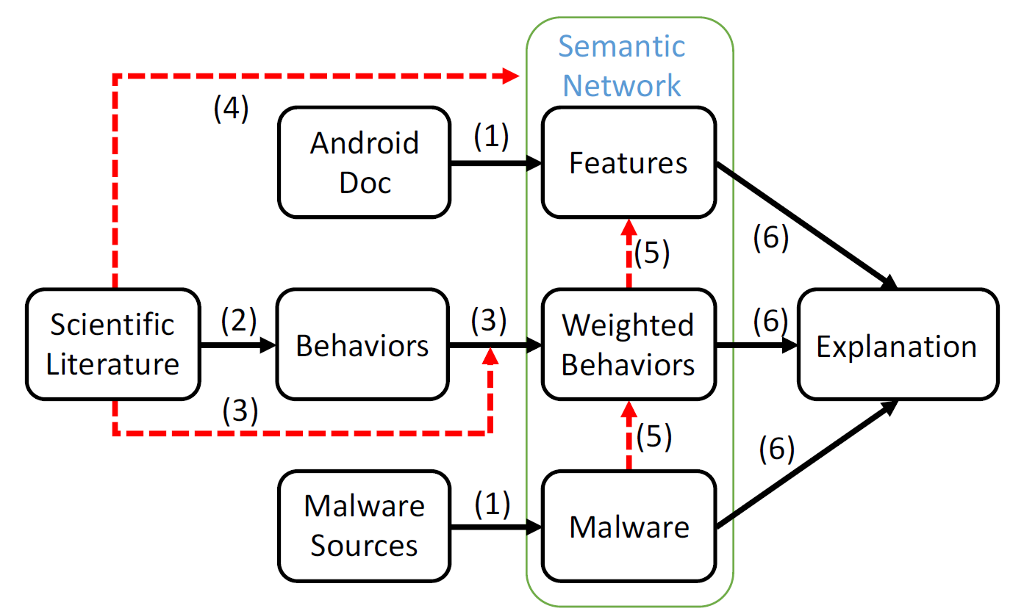
General architecture for automatic feature engineering
Stanford typed dependency parser
(with links)

Slide 9
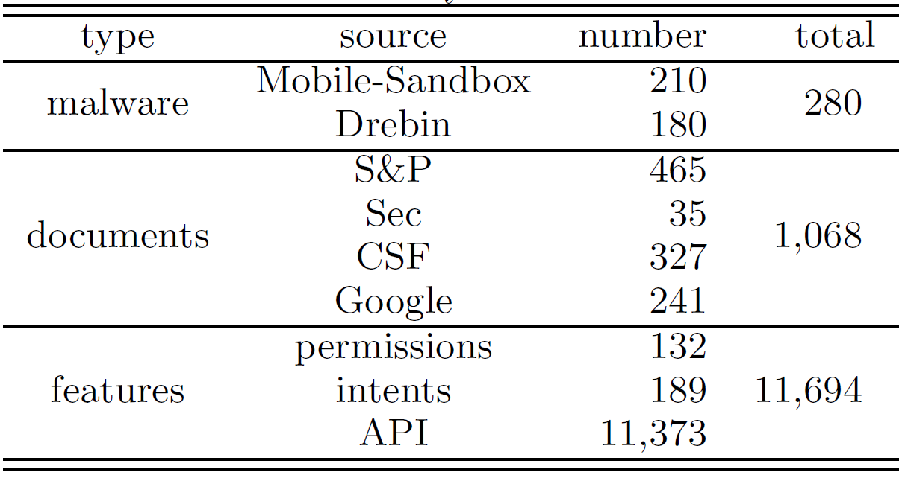
Summary of data sets
(For validation)
(Extracting malware behaviors)

Slide 10
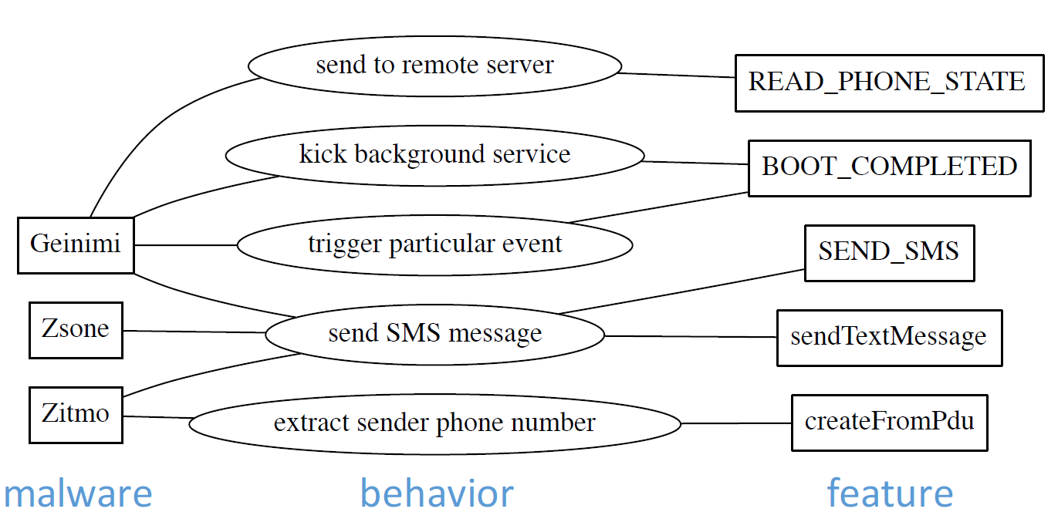
An excerpt from their semantic network

Slide 11
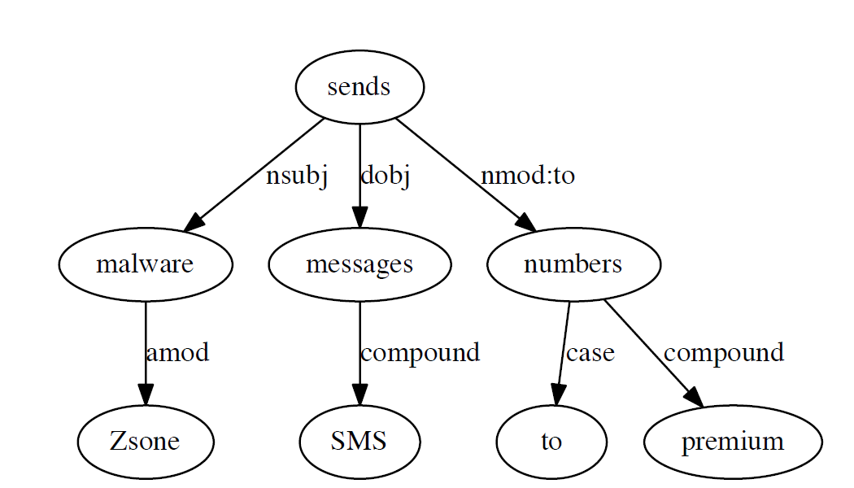
Behavior extraction
Typed dependency of the sentence “Zsone malware sends SMS messages to premium numbers”
Governor
Dependent

Slide 12
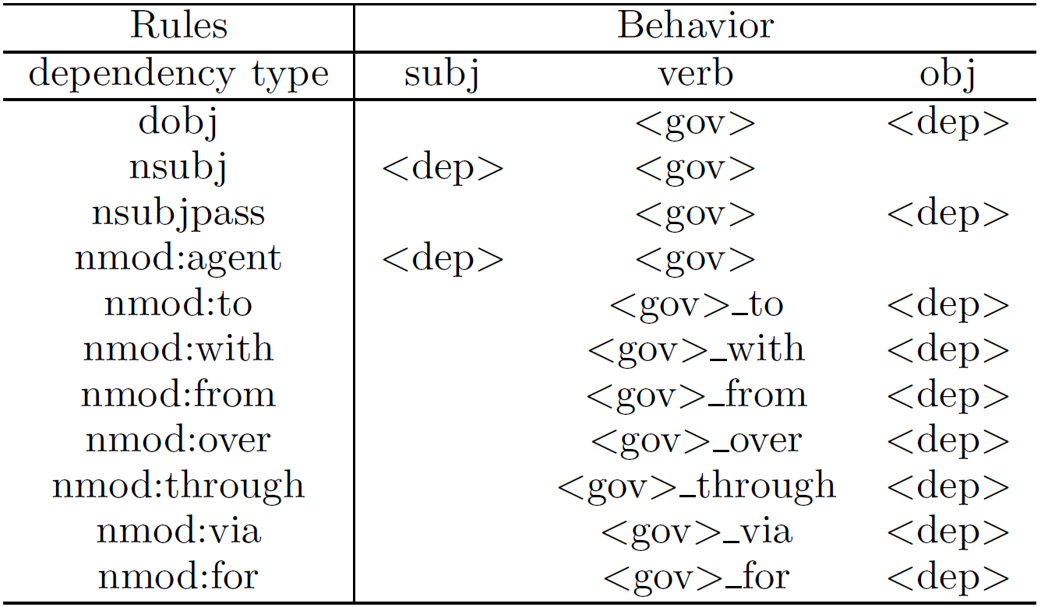
Rules for matching behaviors. <gov> - governor; <dep> - dependent

Slide 13
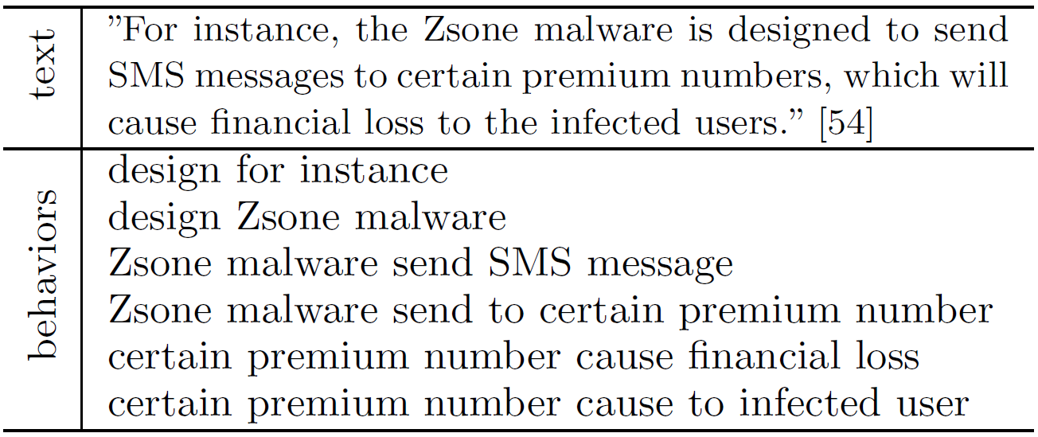
An example of behavior extraction

Slide 14
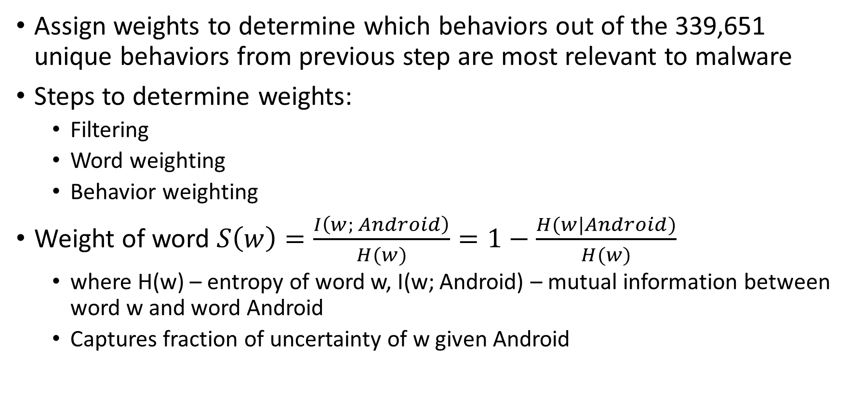
Filtering and weighting
Assign weights to determine which behaviors out of the 339,651 unique behaviors from previous step are most relevant to malware
Steps to determine weights:
Filtering
Word weighting
Behavior weighting
Weight of word $S\left(w\right)=\frac{I\left(w; Android\right)}{H(w)}=1−\frac{H(w|Android)}{H(w)}$
where H(w) – entropy of word w, I(w; Android) – mutual information between word w and word Android
Captures fraction of uncertainty of w given Android

Slide 15
Semantic network construction
Undirected graph G = (V, E)
V contains concepts extracted; E captures pairwise relations among these concepts
Each edge has a weight capturing semantic similarity
3 types of nodes – malware families, behaviors, features
2 types of edges:
links between malwares and behaviors
Links between behaviors and features

Slide 16

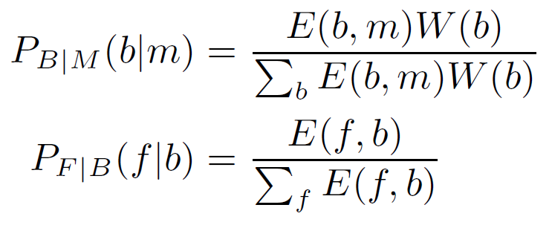

Feature generation
For random variables M – malware, B – behavior, F – feature, probability of feature $π_{F}$:
Transition probabilities:
E(i,j) – edge weight of semantic network
W(b) – weight of behaviors

Slide 17
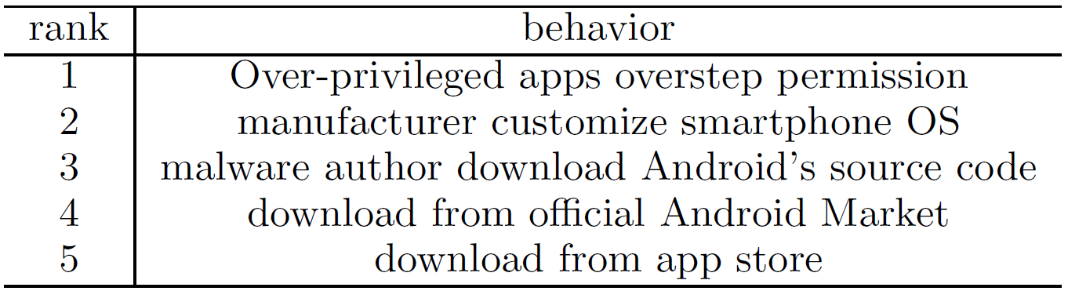
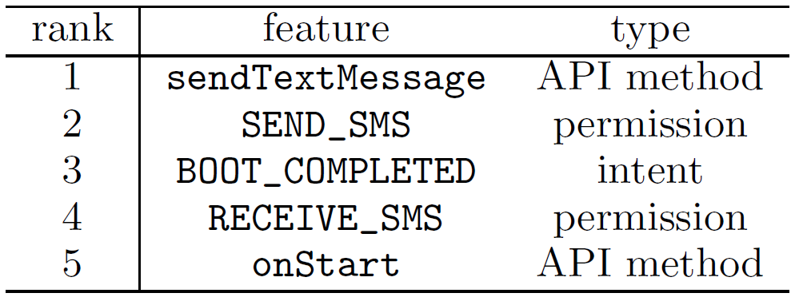
Top 5 behaviors related to Android
Top 5 features

Slide 18
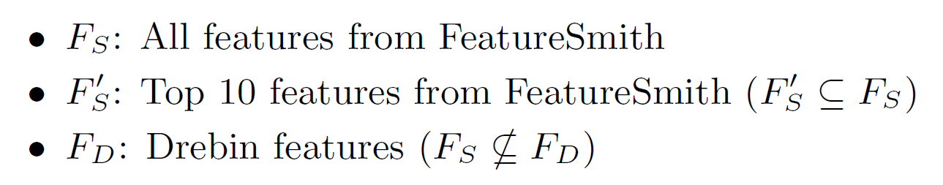
Evaluation results
Train 3 random forest classifiers:
Plot Receiver Operator Characteristic (ROC) graphs
Term Frequency (TF) metric to extract frequent keywords

Slide 19
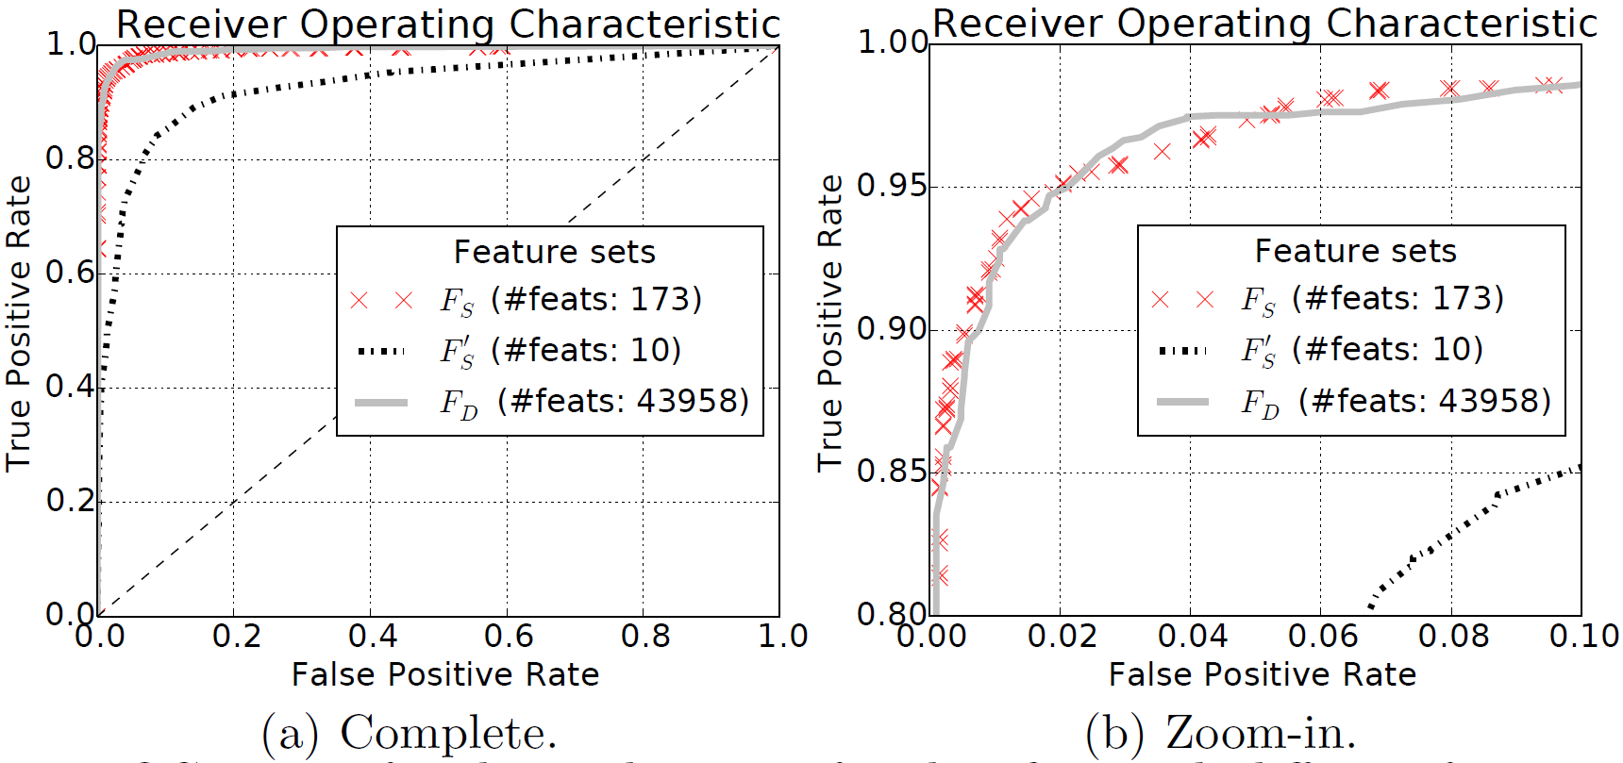
ROC curve of malware detection or classifiers with different feature sets

Slide 20
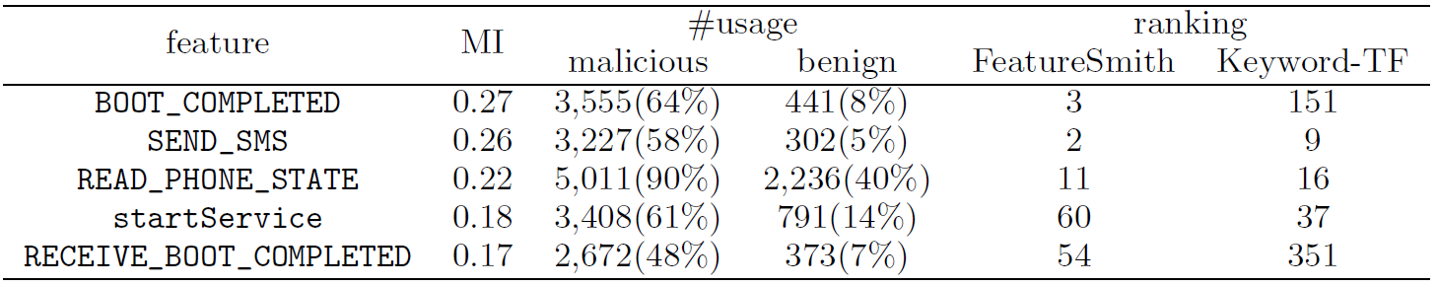
5 most informative features

Slide 21
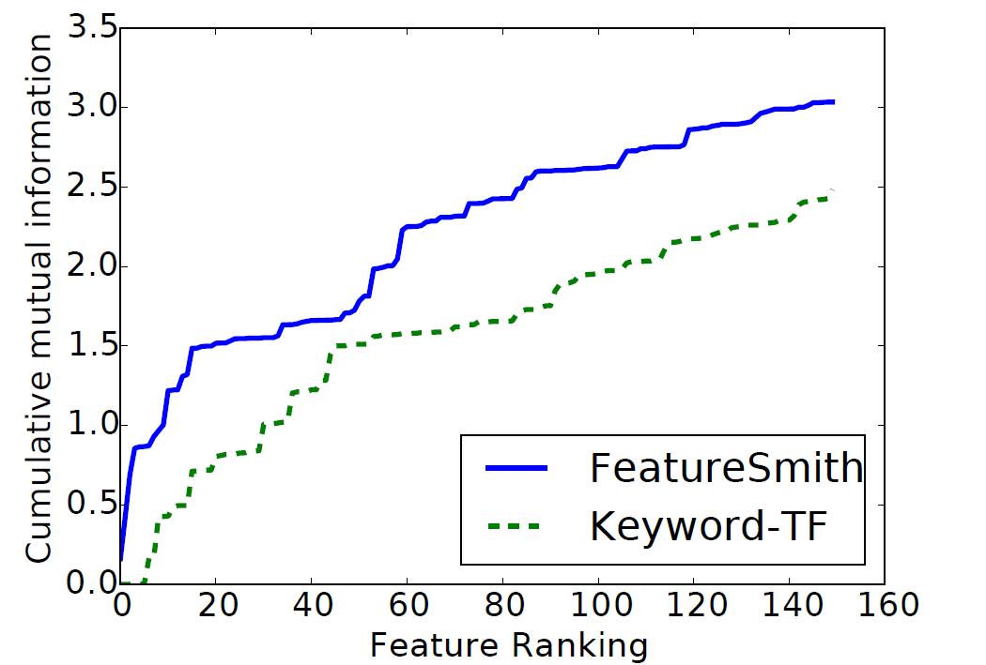
Cumulative mutual information of top-ranked 150 features

Slide 22
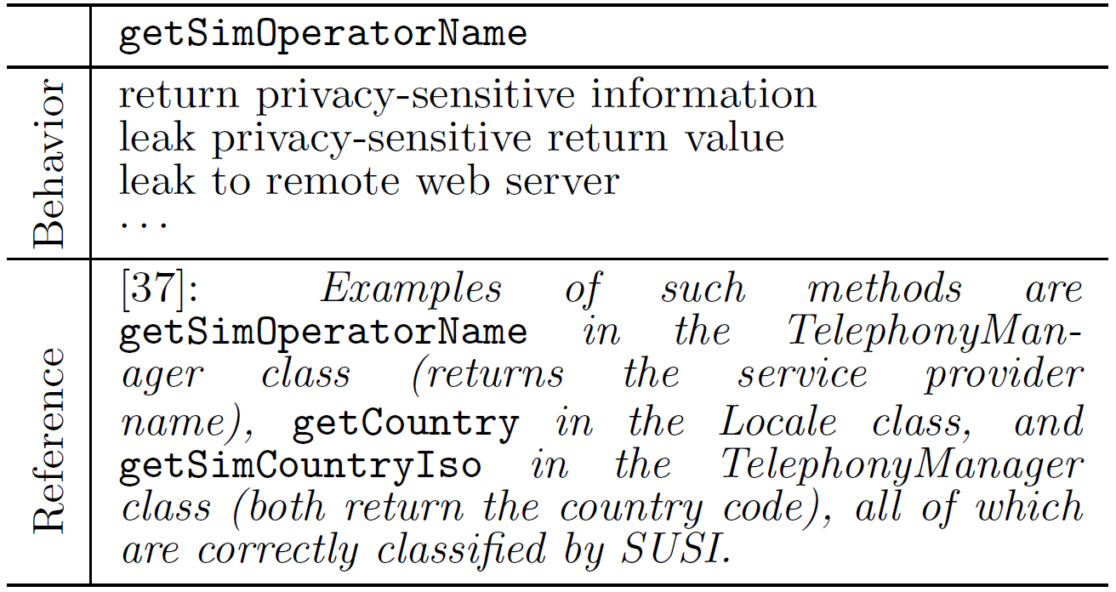
An example of feature explanation

Slide 23
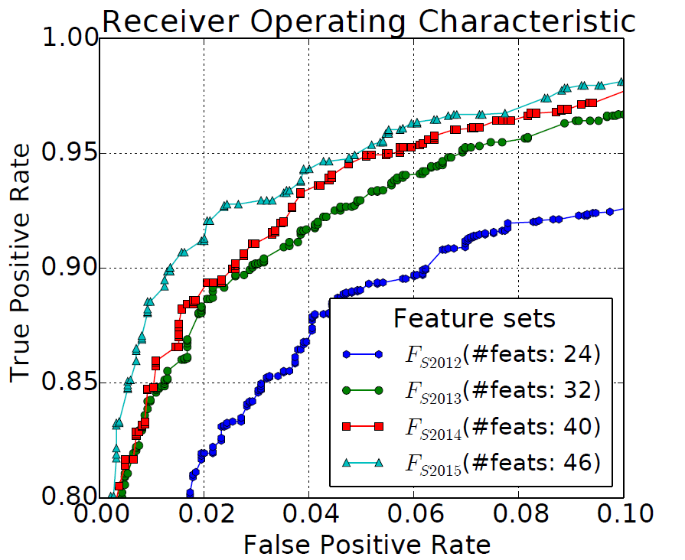
Knowledge evolution over time

Slide 24
Limitations
Works under the assumption that a feature is a named entity
If the features are associated with some operation, their current implementation cannot identify them automatically
Ex: “max” or “number of”
Attackers can find new techniques to evade since humans are absent

Slide 25
Concluding remarks
FeatureSmith – automatic engineering of features for malware detection
Represent using a semantic network
Captures semantic similarity between abstract malware behaviors and concrete features
Characterized evolution of knowledge over four years
92.5% true positive and 1% false positive
Find features that are overlooked in the manual counterpart
Feature explanation

Slide 26
References
Ziyun Zhu and Tudor Dumitras. FeatureSmith: Automatically Engineering Features for Malware Detection by Mining the Security Literature. CCS ‘16 October 24-28, 2016, Vienna Austria.
http://developer.android.com/index.html
www.virustotal.com

